Slide 1
Task – Real Time Attendance

Slide 2
Features
Authentication – Login/Signup.
Authenticated Dashboard.
Total Hours Given on a Particular Day.
Punch In/out Option for Present Day.
Real-time Timer.
Punch In/Out history of Present Day/Selected Day.

Slide 3
Authentication
Login/Signup/Forget Password.
Based on Jwt Authentication where token is generated, to give user access.
Jwt expires within 24hrs.
Unique Id for all the users(including their punches) and users/punches can’t be replicated.
Exception are handled example – invalid punch in/out, invalid credentials when signing up/ logging in /changing password.

Slide 4
Authenticated Dashboard And Dashboard Features:
Only authenticated user can view the dashboard.
Authentication done but Jwt that verifies the user’s email and fetch their data(unique).
Day wise data of their punches in/out.
Total hour given in a particular day.
Real time Clock to show how much time has passed.

Slide 5
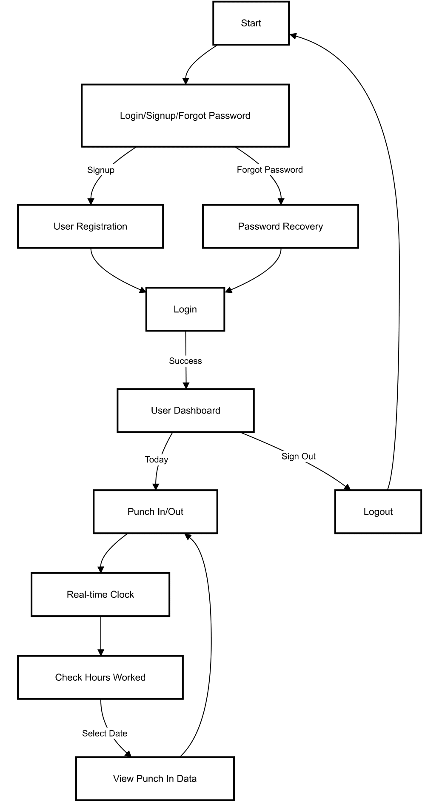
FlowChart:
1)User can go to Login/Signup/Forgot pass page.
2) User can create their account/change their password will be redirected to the Login Page.
3) Authenticated User can go to dashboard.
4) Can punch in/out for the present day
5) Can see the punch history/total hours given for the present day/selected day.
6) Logout – token is removed

Slide 6
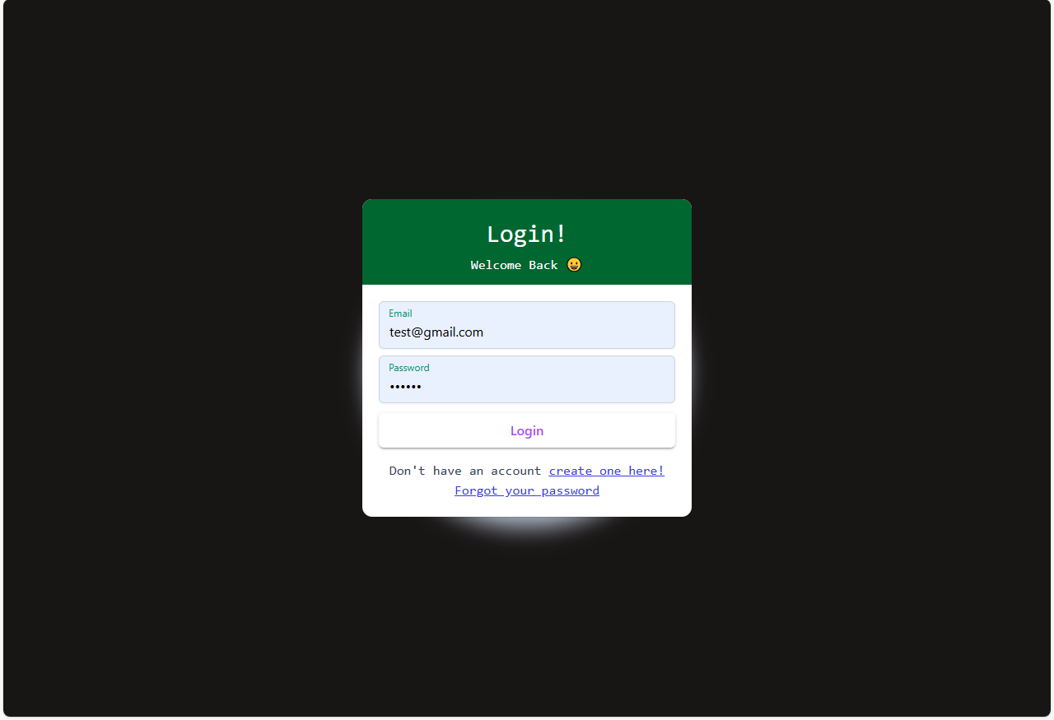
Login:

Slide 7
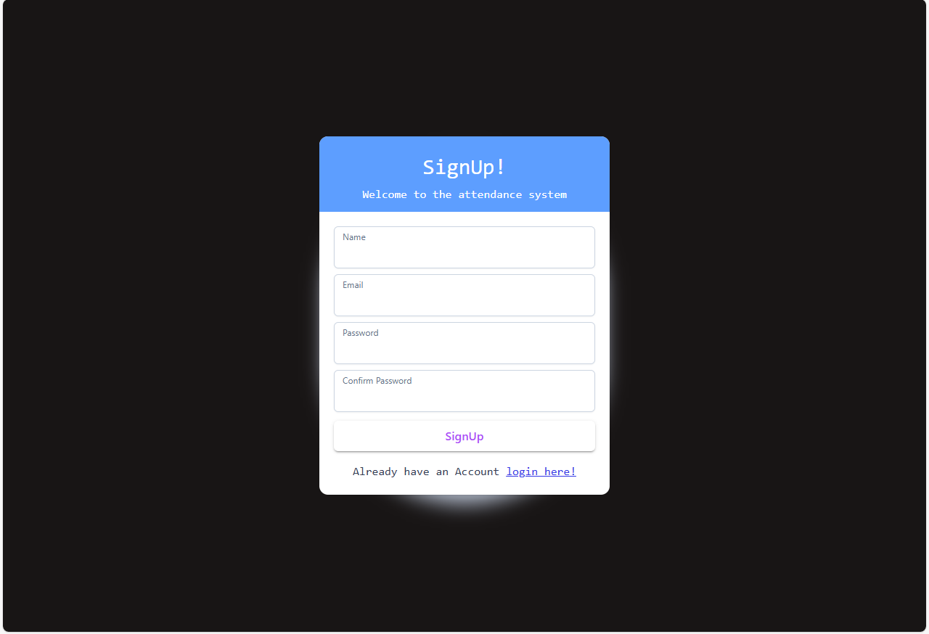
SignUp:

Slide 8
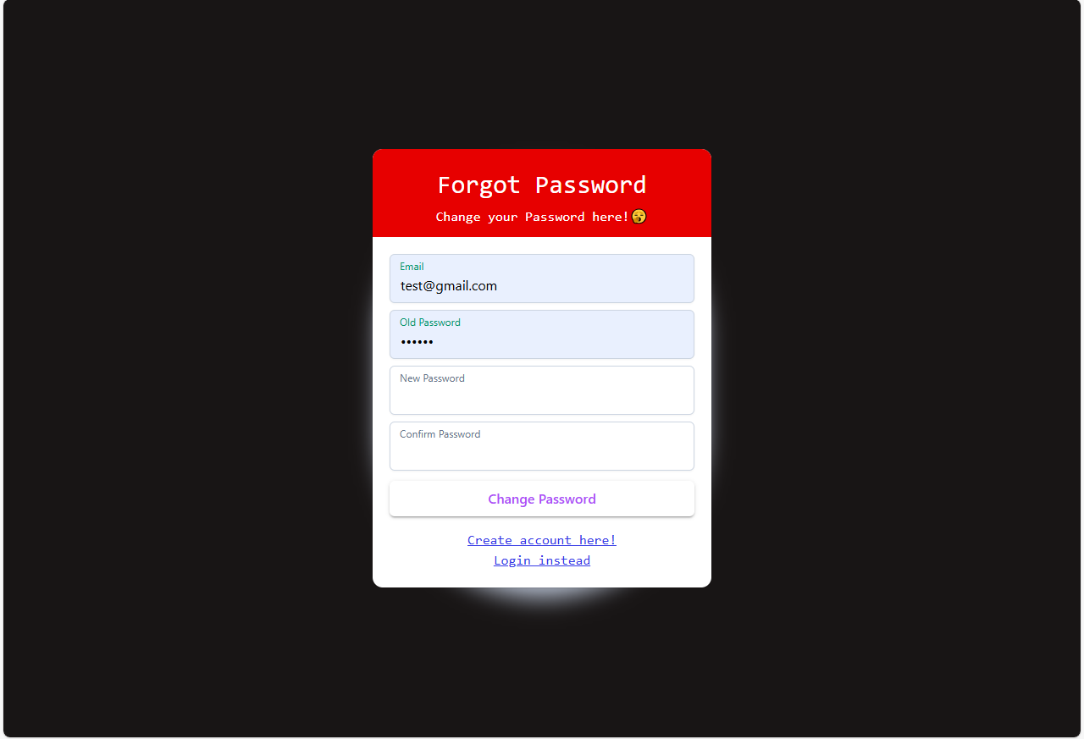
Forget Password:

Slide 9
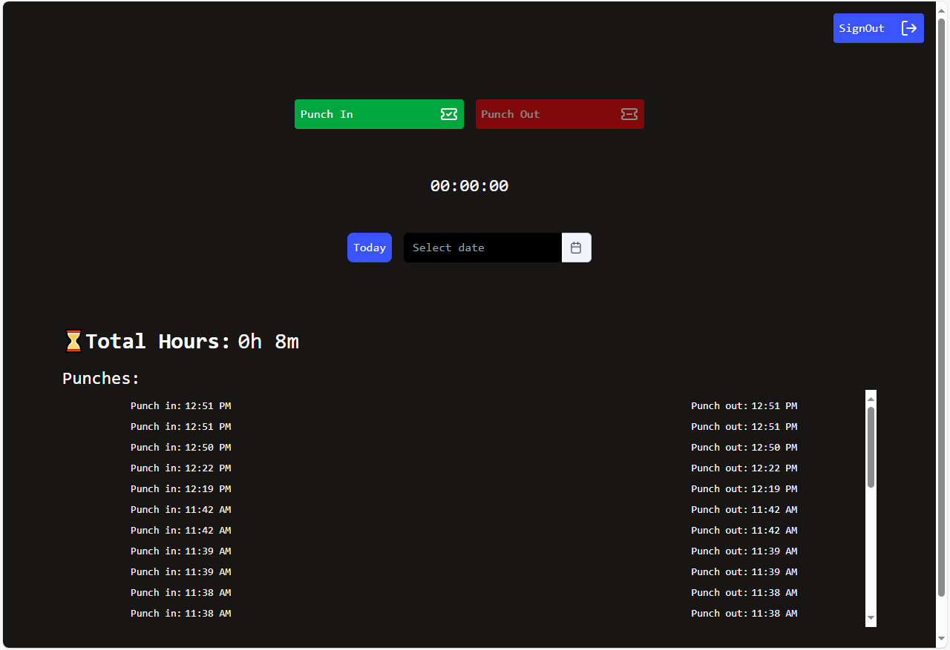
Dashboard:

Slide 10
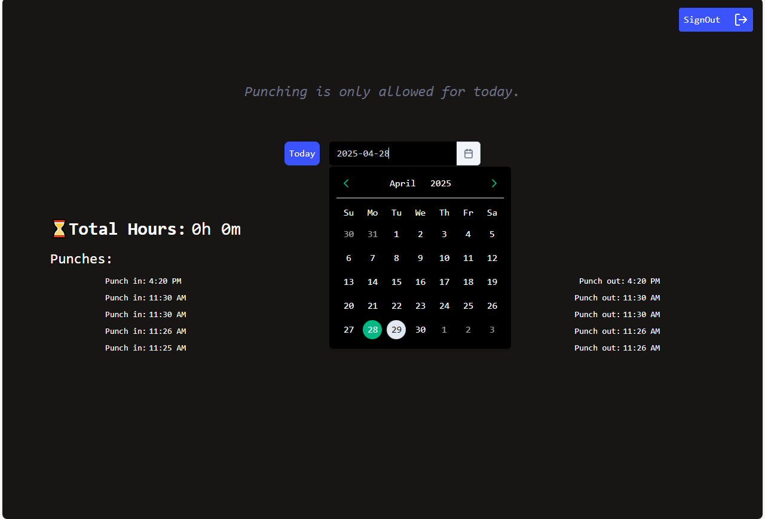
Selected Date Section:

